Slide 1
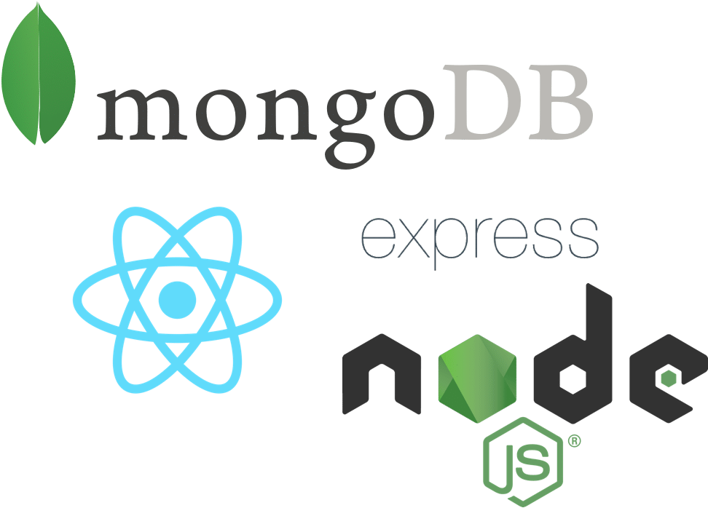


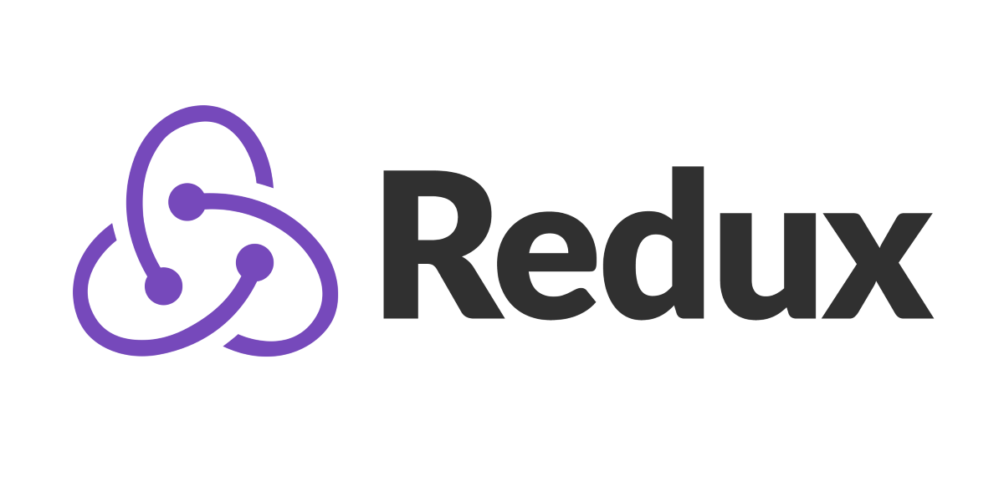



Solution Architecture
Bcryptjs for password handling
JWT for user authorization
React Redux for state management
MERN Stack for front/backend development
Bootstrap and CSS (vanilla) for styling
Heroku to deploy app

Slide 2
Task Manager App Walkthrough

Slide 3
https://youtu.be/rdK6Myjwhws

